Slide 1
JAVASCRIPT FRONT END
OBJECTIVES & SCHEDULE

Slide 2

OBJECTIVES
CHAPTER 1
Be able to code in JS as well as in Python
Be able to create elements in HTML using JS
Be able to interact with events
Be able to validate forms
Create an application to add, edit, remove items in a list
CHAPTER 2

Slide 3

SCHEDULE
6 WEEKS
THEORY / PRACTICE
2 WEEK
PROJECT
December
08
December
11
December
22
November
01

Slide 4
Course evaluation
Quizzes
Participation
Midterm exam
Project
10 %
10 %
30 %
50 %

Slide 5
YOUR BEHAVIOR IN CLASS
ACTIVE =
CURIOUS
CREATIVE
EXPRESS YOURSELF
WORK IN TEAM

Slide 6
CHAPTER 1
PYTHON to JS
PART 1
WHAT IS JAVASCRIPT ?

Slide 7



EXPLORE
Open /exercice1 and run the HTML
15 MIN
Q1 - What does the script is doing ?
Q2 - Remove the script –run – what’s happen ?
Q3 – Between HTML and JS which one is start running first?
Q4 – Change the script to write THE BEST on the second paragraph
Q5 – Disable JavaScript on Chrome :
https://www.tutorialspoint.com/javascript/javascript_enabling.html
What ‘s happen ?

Slide 8
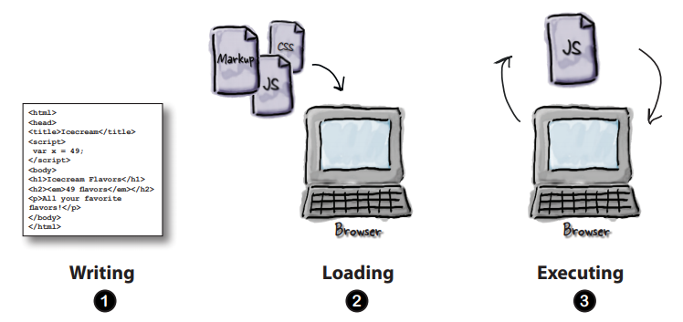
EXPLAIN
JS is the language understood by browsers
15 MIN
Notes:
- JS is the language to control your HTML and CSS
https://www.w3schools.com/js/js_intro.asp
All the modern browsers come with built-in support for JavaScript
- Exercise disable the JS support on your browser and see what's happen with the tag <noscript>
https://www.tutorialspoint.com/javascript/javascript_enabling.htm

Slide 9
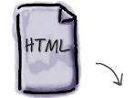
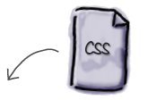


EXPLAIN
JS bring the behavior to your web application
CONTENT
STYLE
BEHAVIOR

Slide 10
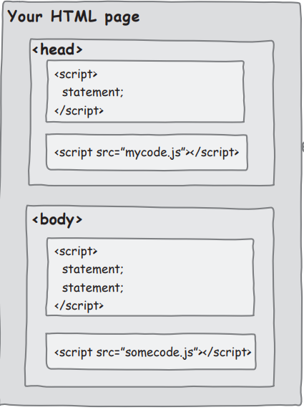
EXPLAIN
Like CSS : many places to write your JS code
You can write JS
inside the <head>
Or write JS
inside the <body>
Or write JS
In external file
(most common)

Slide 11
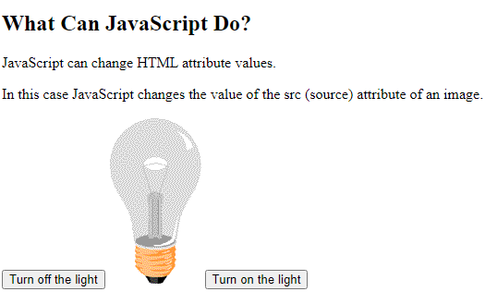
EXPLORE
Open /exercice2 and run the HTML
15 MIN
Q1 - Look at the code and find the way to turn on the light when we lick on button ON
Note: you have 2 images…
Notes:
- Different way to write your JS !
https://www.w3schools.com/js/js_whereto.asp
- Different ways to output using JS !
https://www.w3schools.com/js/js_output.asp

Slide 12
EXPLAIN
External JS advantages
It separates HTML and code
It makes HTML and JavaScript easier to read and maintain
Cached JavaScript files can speed up page loads
yourFile.js

Slide 13
EXPLORE
Open /exercice3
15 MIN
Q1 - Read following page https://www.w3schools.com/js/js_output.asp
Understand how to :
Write something in the console
Write something in the HTML document
Display an alert
Q2 - Edit the script to :
Write something in the console
Write something in the HTML document
Display an alert

Slide 14
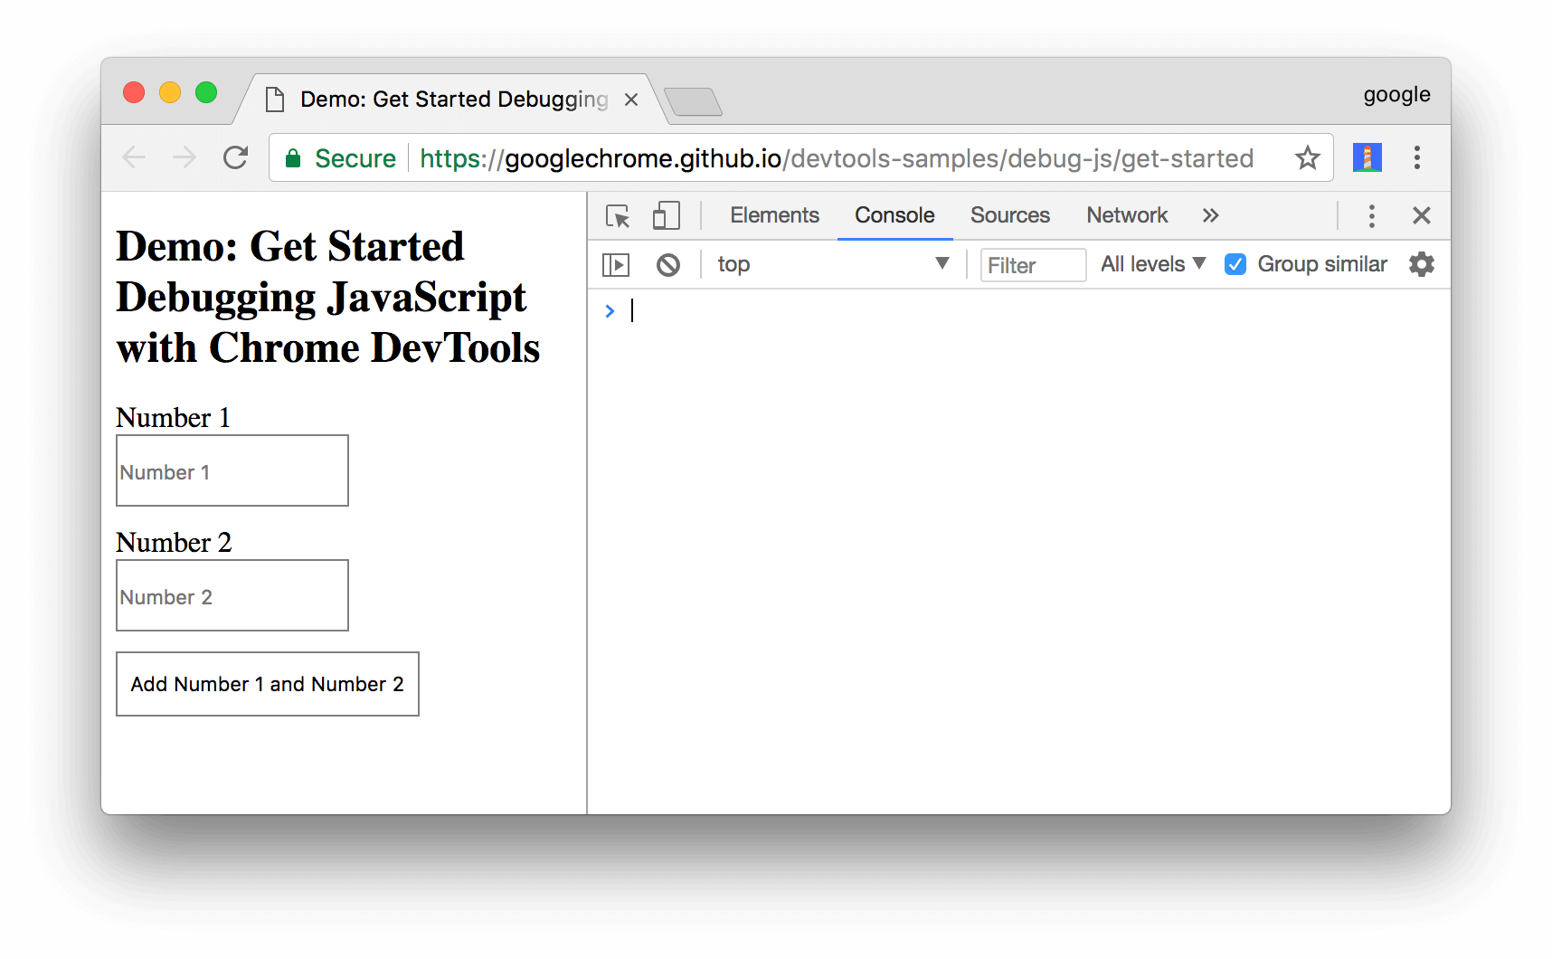
More info : https://developers.google.com/web/tools/chrome-devtools/javascript
Open DevTools by pressing Control+Shift+I

Slide 15
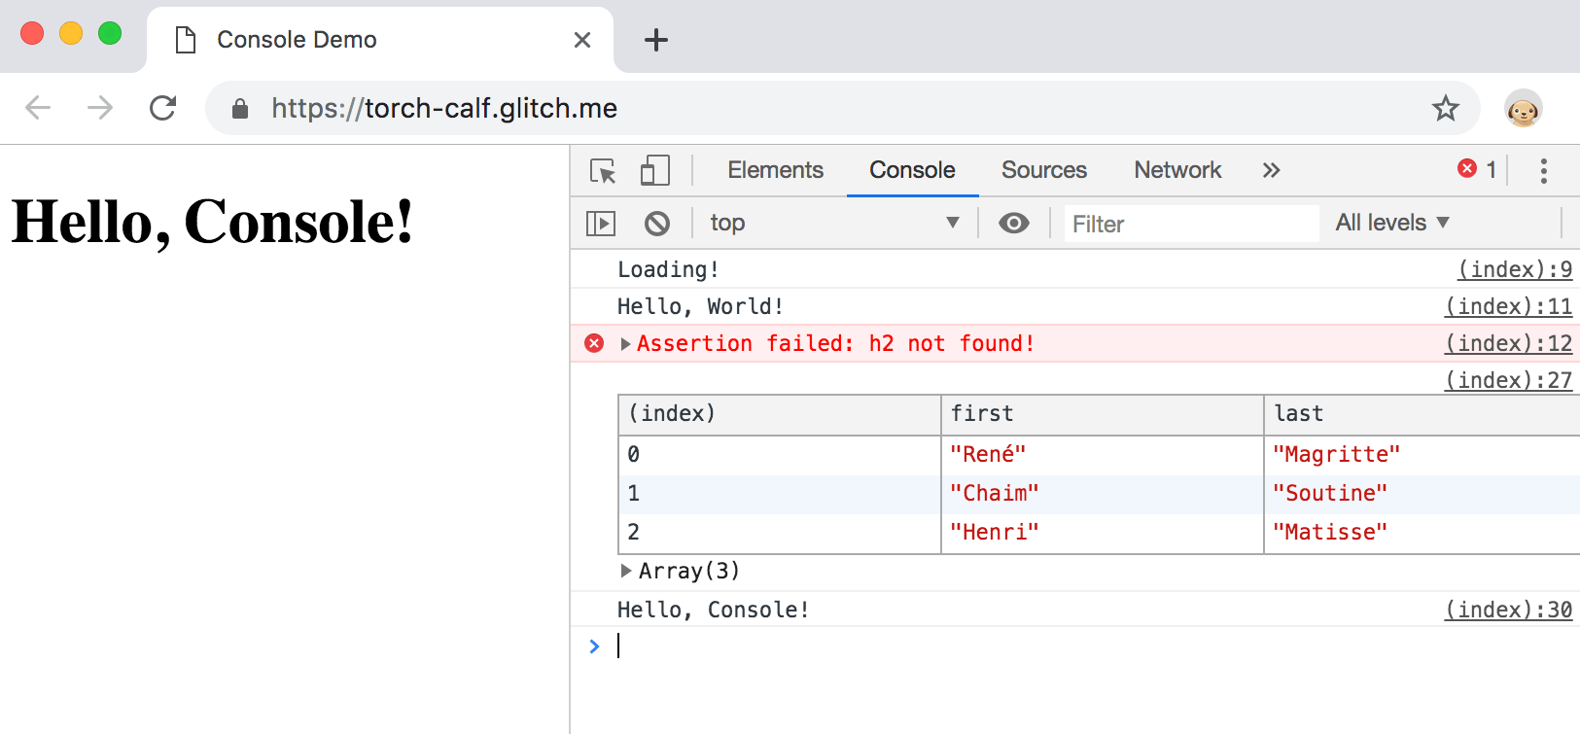
EXPLAIN
CORRECTION / DEMO
Can you access to the
Console ?

Slide 16

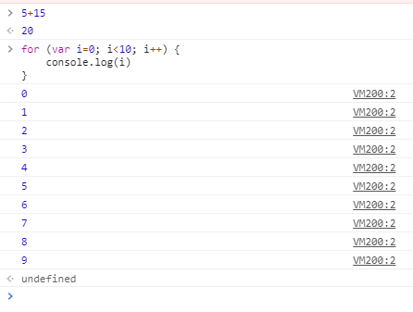
You can execute directly JS code in the chrome console !!!

Slide 17
EXPLAIN
How to DEBUG ?
Using VS code
Using CHROME
Notes:
- How to work with chrome : console/debugger
- How to work with VS code : ESlint /debbuger

Slide 18
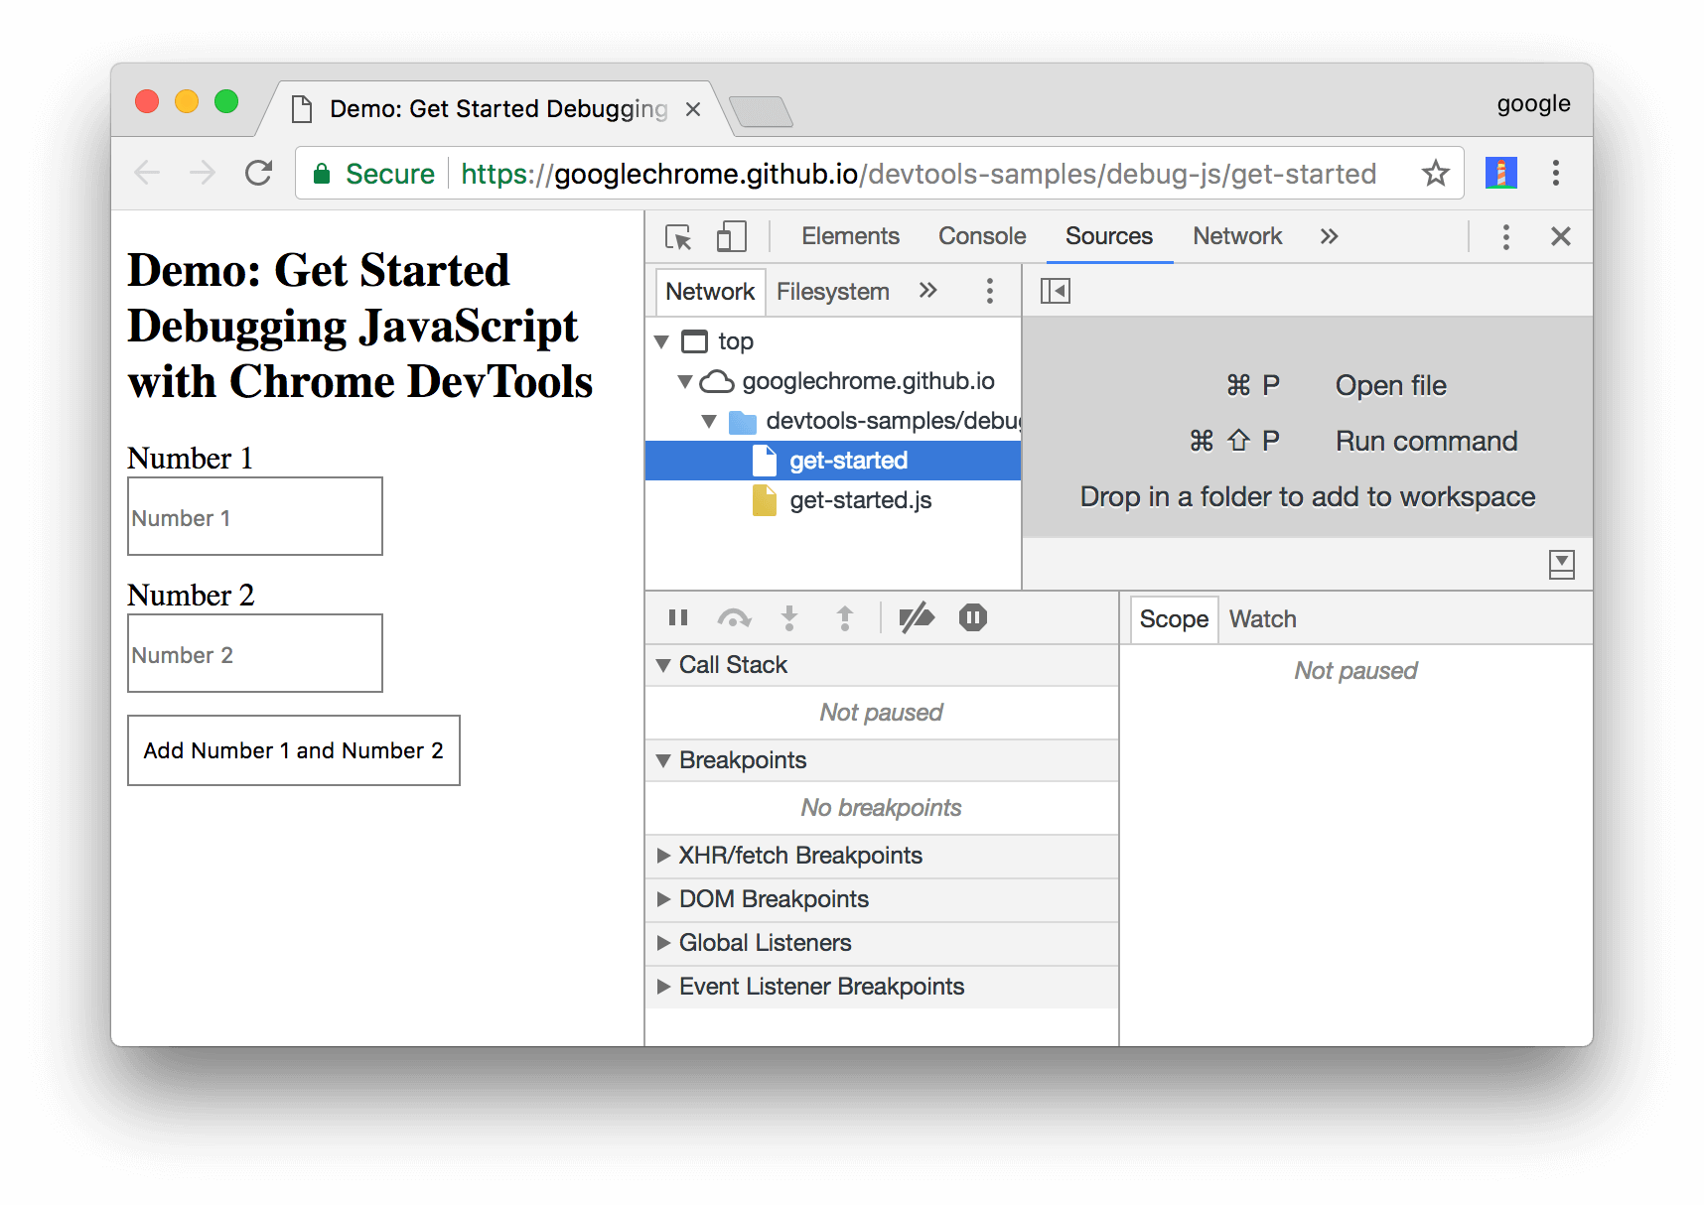
EXPLAIN
Click the Sources tab.

Slide 19
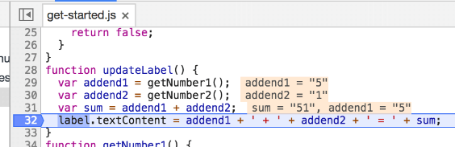
EXPLAIN
Add a breakpoint : click on the line you want the code to stop

Slide 20

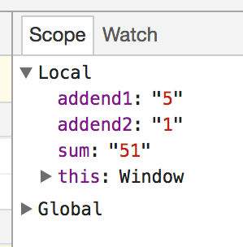
EXPLAIN
Use the debug navigation to go step by step or exit the debug mode
Check the variable of your code

Slide 21
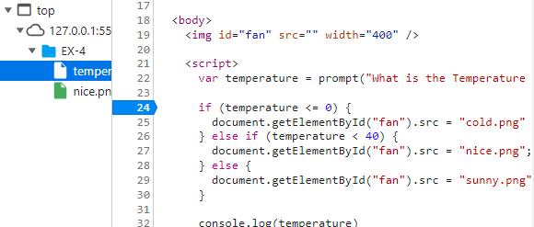
EXPLORE
Open /exercice4
15 MIN
1 – Execute the HTML in the browser
2– Add a break point at line 24
3– Go step by step in the IF / ELSE IF / ELSE condition
Try this for different temperatures

